Slide 1
Chapter 11: Model deployment

Slide 2
Contents
Deploying Models
Code Generation
Scoring and Exploring Results
Demo

Slide 3
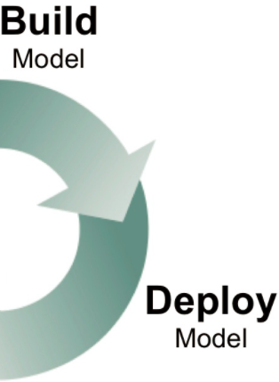
Deploying Models
Once developed model must be deployed!
Knowledge Studio provides two methods to deploy models
Directly applying the model
Generating code for the model

Slide 4
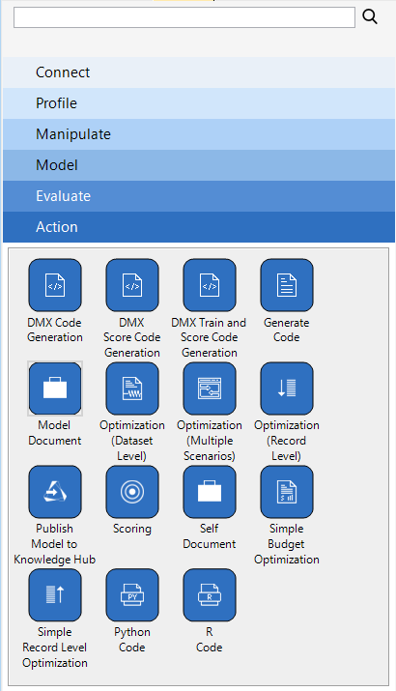
Action Palette
Code Generation
Generate Code note
Automatic
Error free
Scoring
Generate scores, as a set of fields in a new dataset, using the Scoring node
Can then export the scores to a dataset or database

Slide 5
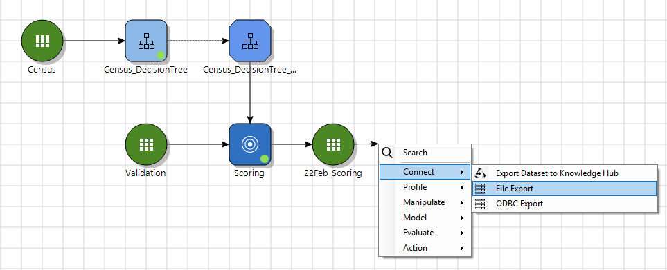
Connect Palette
Export scored results to a data source
Demo

Slide 6
Chapter 11 Exercise (1/1)
Create a Decision Tree Model Instance and use it to score and create a new dataset
Which new fields are created by Scoring? Use the Overview Report to explore
What is the range of predicted probabilities that were generated? Use a Dataset Chart to explore
Export the scored dataset to .xlsx format
Choose Generate Code node, and export code for the model. Try a few different formats

